Slide 1
A DUAL-BACKBONE FUSION MODEL FOR VIDEOGAME SCREENSHOT CLASSIFICATION
JUAN CAMILO NIÑO — NICOLÁS ACEVEDO
DEEP LEARNING (2025-II)

Slide 2
PROBLEM STATEMENT
TASK: CLASSIFY A SCREENSHOT INTO ONE OF 10 GAMES
INPUT: RGB IMAGE (224×224) → OUTPUT: 10 LABELS
APPLICATION: INDEXING, RETRIEVAL, MODERATION

Slide 3
Bingsu/Gameplay_Images (Hugging Face)
10,000 PNGs — 10 classes (≈1000/class)
DATASET
Resize → 224×224; stratified splits (64/16/20)

Slide 4
MOTIVATION
GAMES SHARE HUDS, PALETTES → VISUAL CONFUSION
SINGLE MODELS MAY MISS COMPLEMENTARY CUES
FUSION: EXPLOIT THE BEST OF TWO BACKBONES

Slide 5
MODEL OVERVIEW
DUAL BACKBONES
Preprocessing per backbone, GAP, concatenate
Head: Dense(512) → Dropout(0.3) → Dense(10, softmax)
MobileNetV2 + VGG16

Slide 6
TRAINING STRATEGY
STAGE 1: FREEZE BACKBONES — TRAIN HEAD (LR=1E-3)
STAGE 2: UNFREEZE TAIL LAYERS — FINE-TUNING (LR=1E-4)
BATCH=32, TF.DATA PIPELINES, COLAB GPU

Slide 7
METRICS
Macro-F1 (balance per class)
Confusion matrix + qualitative examples
Top-1 Accuracy (primary)

Slide 8
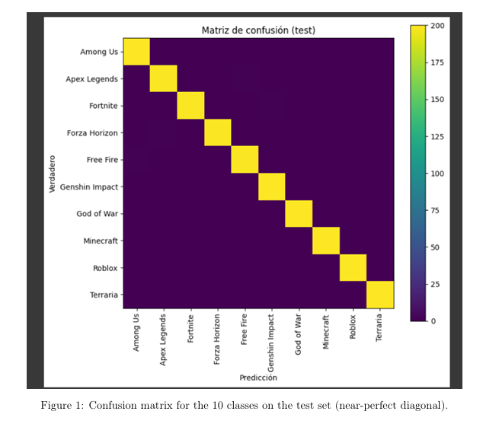
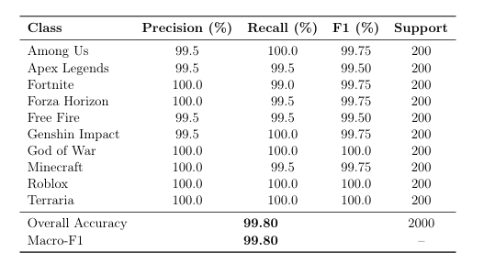
METRICS
Fusion model

Slide 9
1
Test loss: 0.0086
2
Accuracy: 99.80%
QUANTITATIVE RESULTS
3
Macro-F1: 99.80%
4
Per-class F1 ≈ 99.5–100%

Slide 10
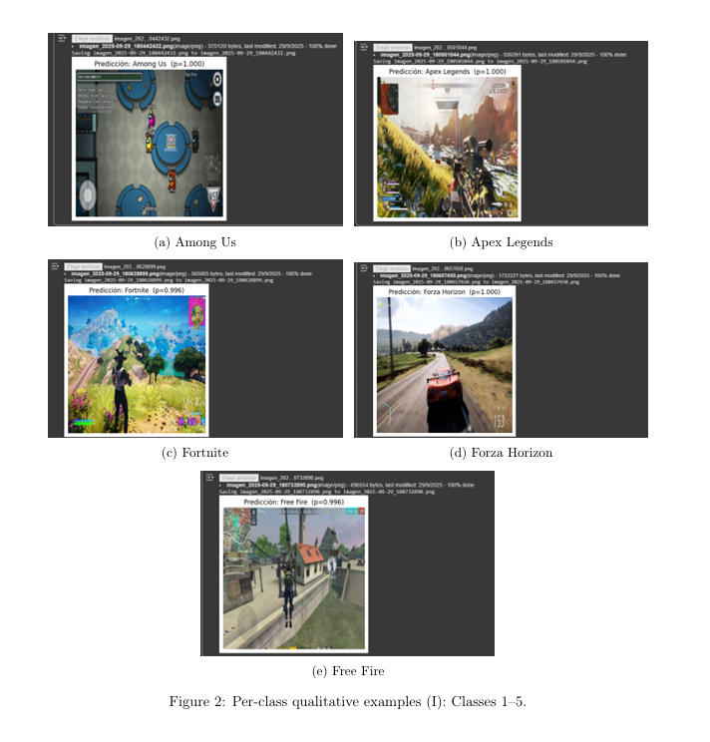
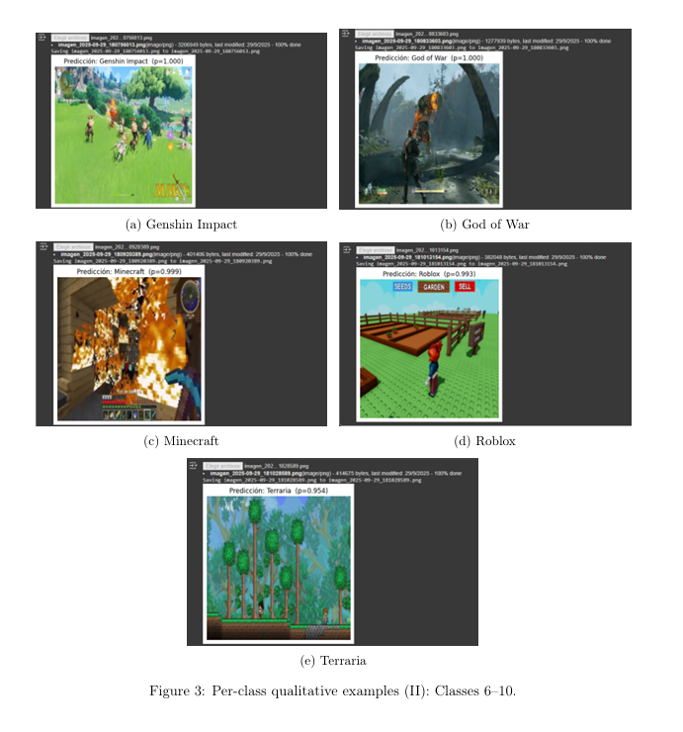
QUALITATIVE EXAMPLES

Slide 11
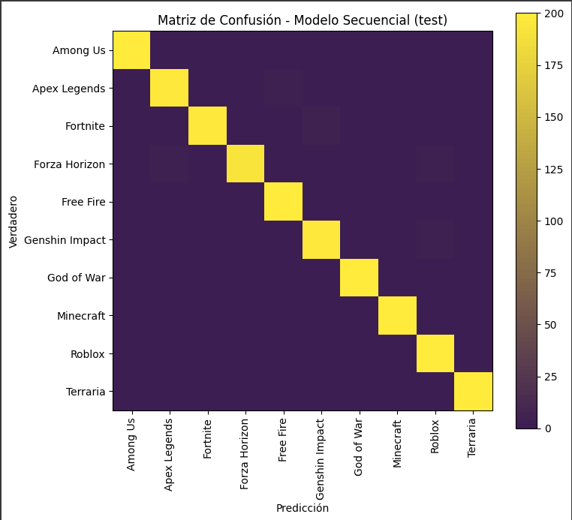
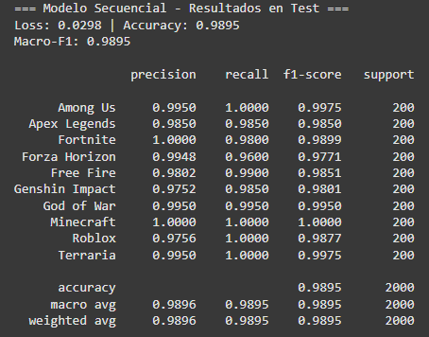
METRICS
Sequence model

Slide 12
1
Test loss: 0.0298
2
Accuracy: 98.95%
QUANTITATIVE RESULTS
3
Macro-F1: 98.95%
4
Per-class F1 ≈ 99.5–100%

Slide 13
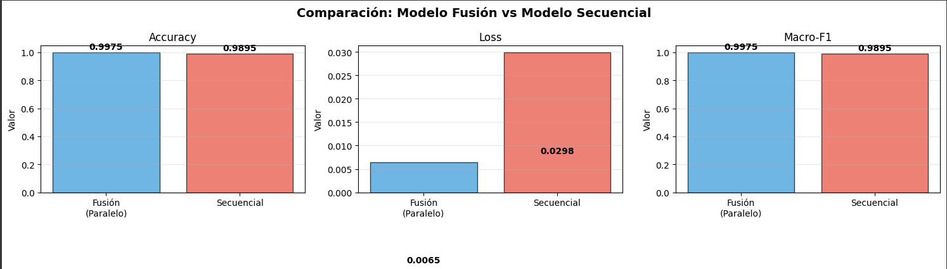
COMPARATIVES

Slide 14
DISCUSSION & LIMITATIONS
STRENGTHS
LIMITS
MITIGATIONS
Alta precisión, robustez entre estilos
Modelo pesado; posible fragilidad ante domain shift
Distillation, augmentations, pruebas cross-source

Slide 15
FUTURE WORK & THANKS
ATENCIÓN PARA FUSIÓN ADAPTATIVA, DISTILLATION, EVALUATION CROSS-SOURCE

